Slide 1
Argument

Slide 2
An argument is a written or spoken piece of communication. Its purpose is to logically and with evidence prove a particular point of view.
The Structure of an argument:
Statement
Body
Conclusion
The language features of a argument include: factual statements, informative language such as “the facts prove ...” , mostly impersonal and unemotional.
The Stages of an argument:
Introduction
Facts and Evidence
Conclusion based on evidence

Slide 3
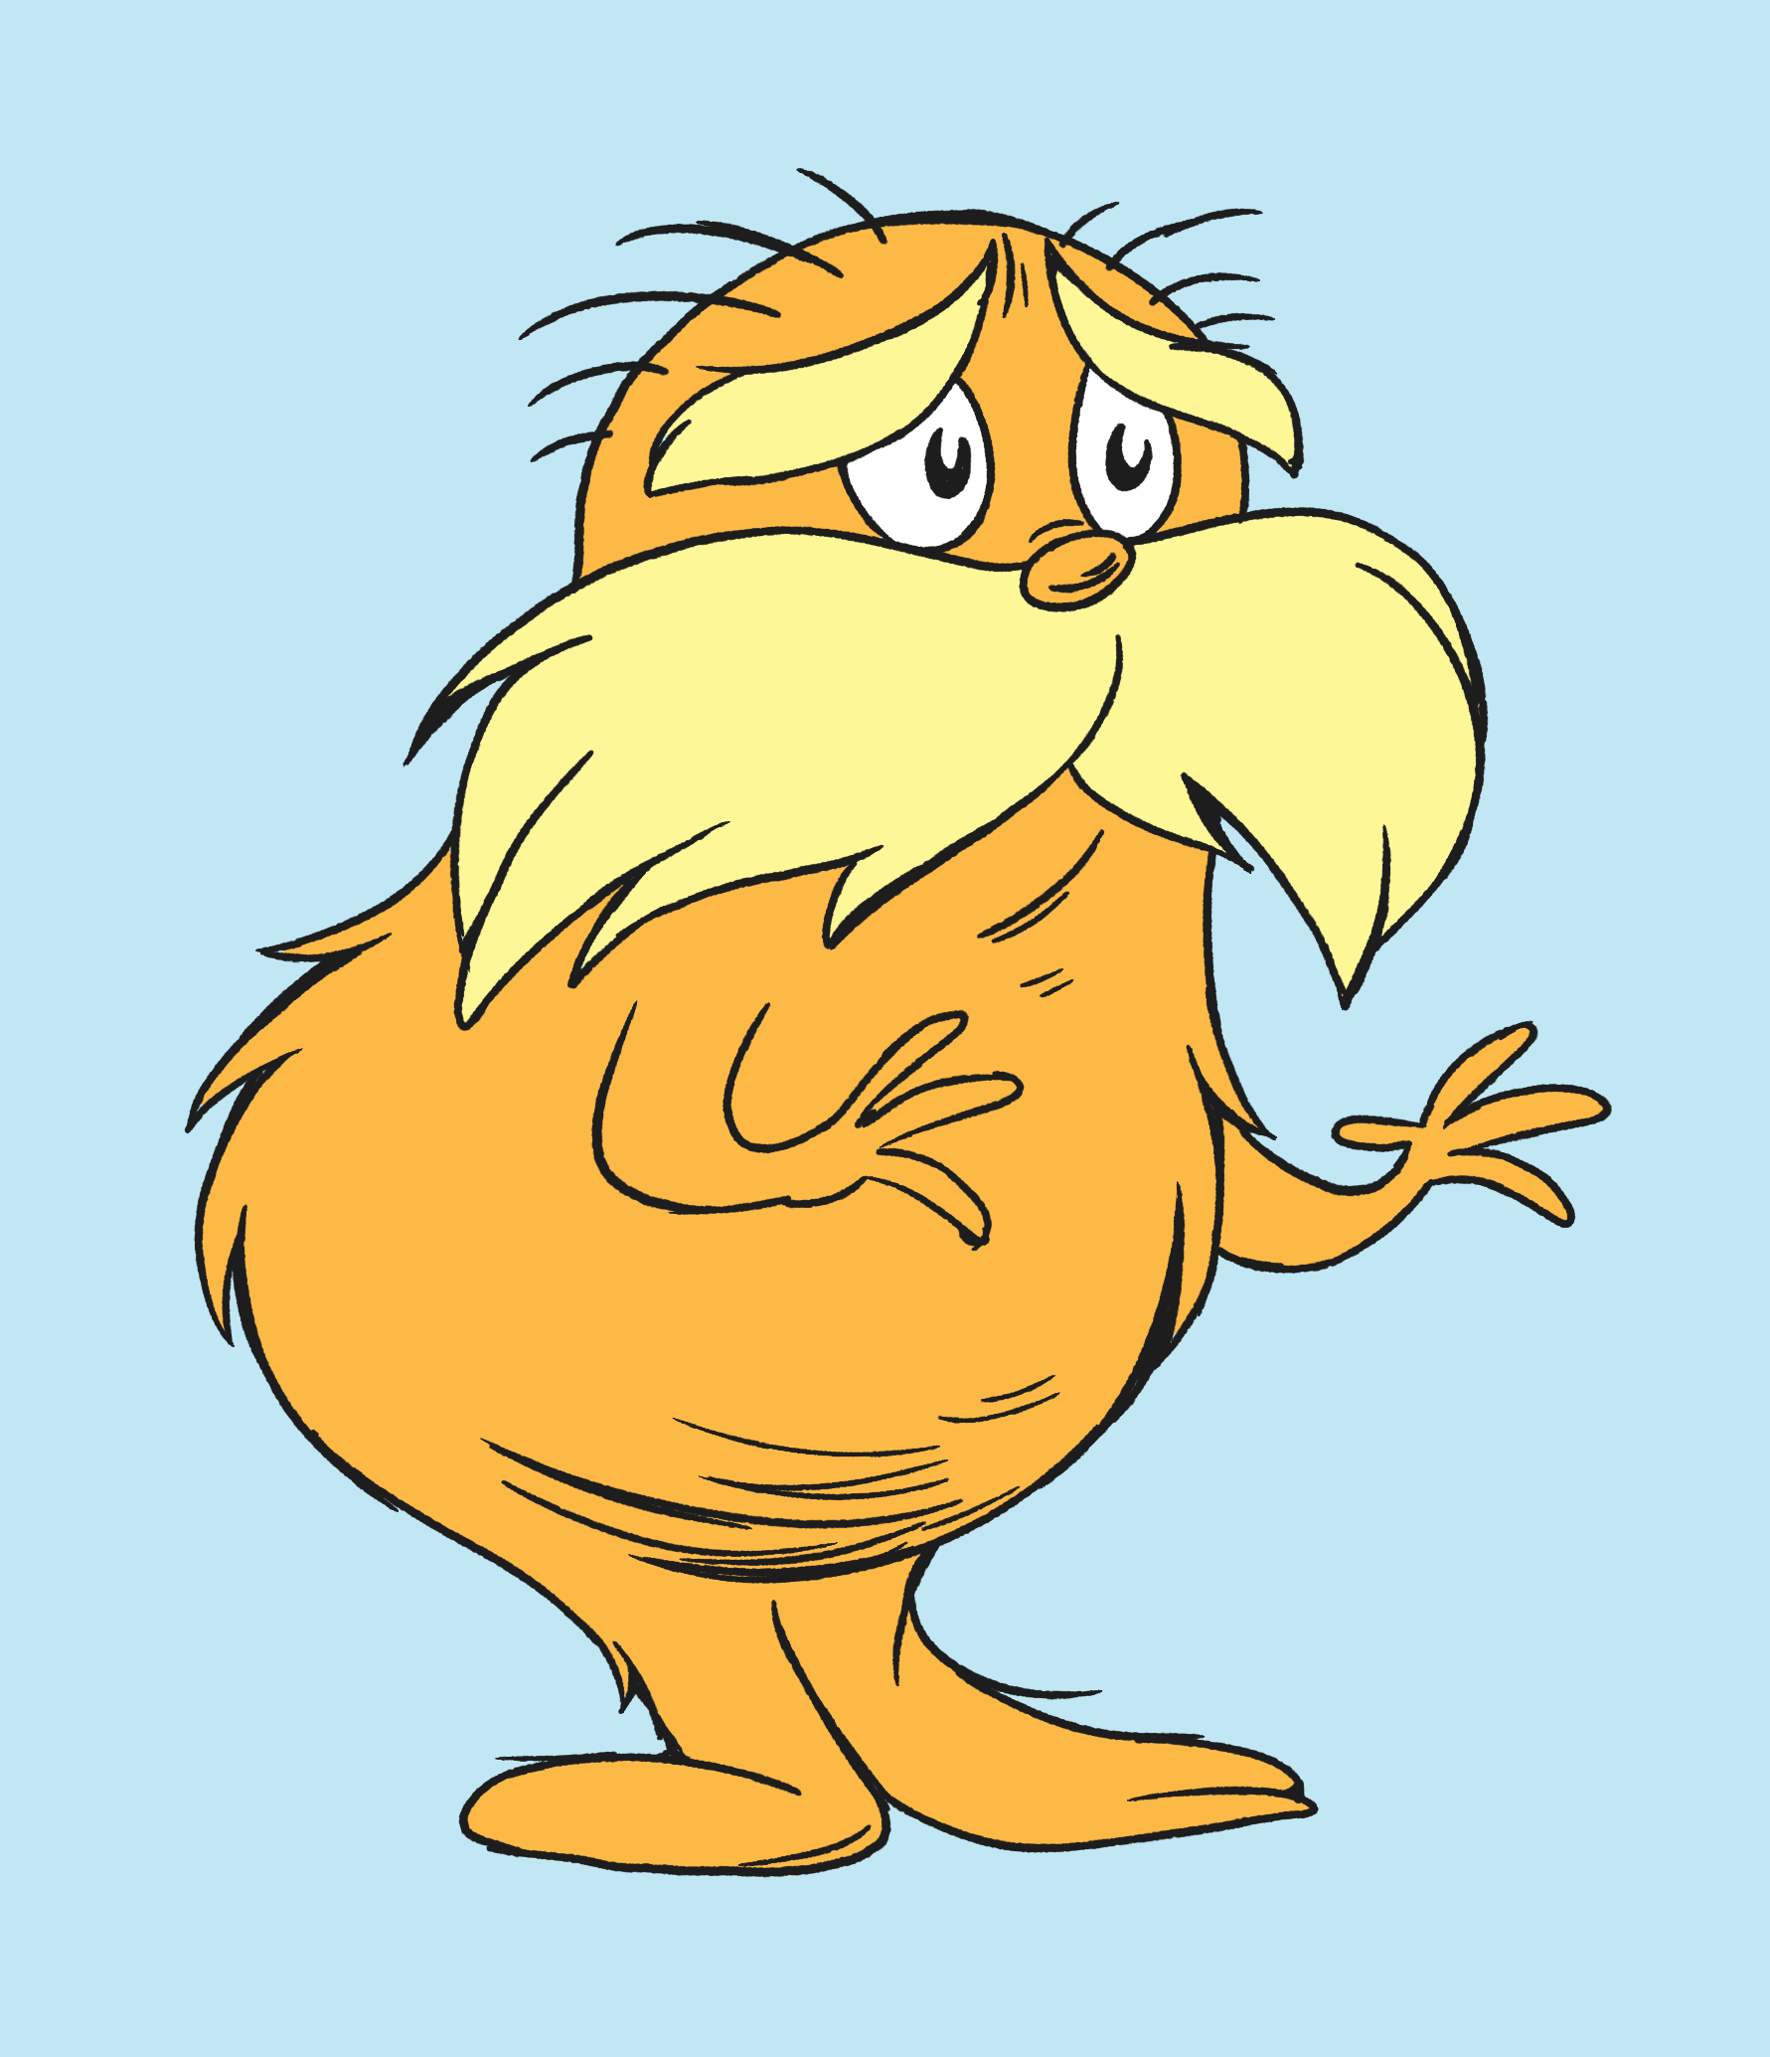
Stage - Introduction Structure - Statement
Introduction of speaker or writer.
“I am the Lorax.”
Introduction of the topic
“I speak for the trees. I speak for the trees for the trees have no tongues.”

Slide 4
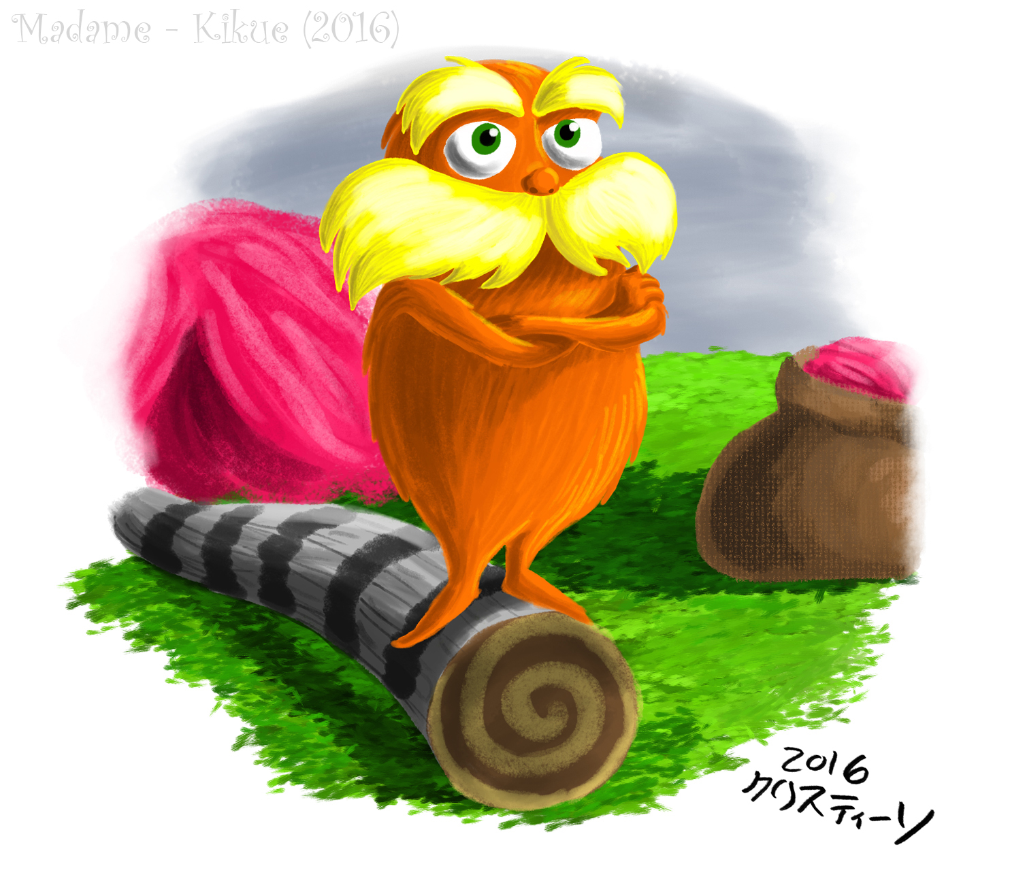
Stage - Facts and Evidence Structure - Body
Facts
“I’m also in charge of the Brown Bar-ba-loots who played in the shade in their Bar-ba-loot suits and happily lived, eating Truffula Fruits.
Now, thanks to your hacking my trees to the ground, there’s not enough Truffala Fruit to go round.
Evidence

Slide 5
Stage - Facts and Evidence Structure - Body
Facts
“Once-ler! You are making such smogulous smoke!
My poor Swomee Swans ... Why they can’t sing a note!
No one can sing who has smog in his throat.
Evidence

Slide 6
Stage - Facts and Evidence Structure - Body
Facts
“Your glumping the pond where the Humming – Fish hummed.
No more can they hum, for their gills are all gummed.
Evidence

Slide 7
Stage – Conclusion based on evidence
Structure - Conclusion
Unless someone like you cares a whole awful lot, nothing is going to get better.
It’s not.

Slide 8
THINK AND SHARE
The Lorax had a point of view to argue with the Once-ler. What was that point of view?
What arguments and evidence did the Lorax use to strengthen his viewpoint?
Did the Lorax win or lose the argument?Discuss

