Slide 1
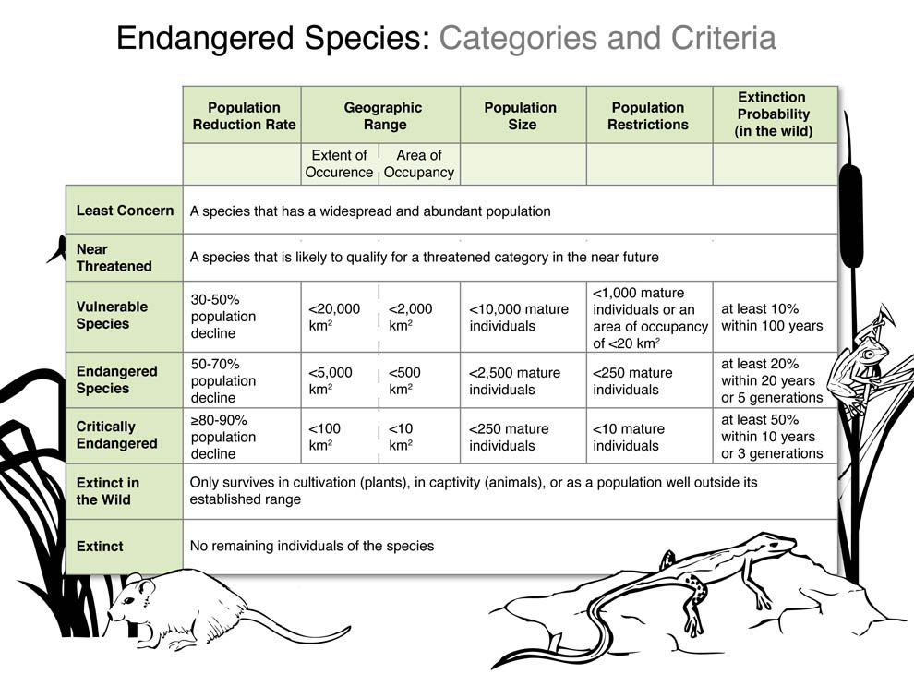
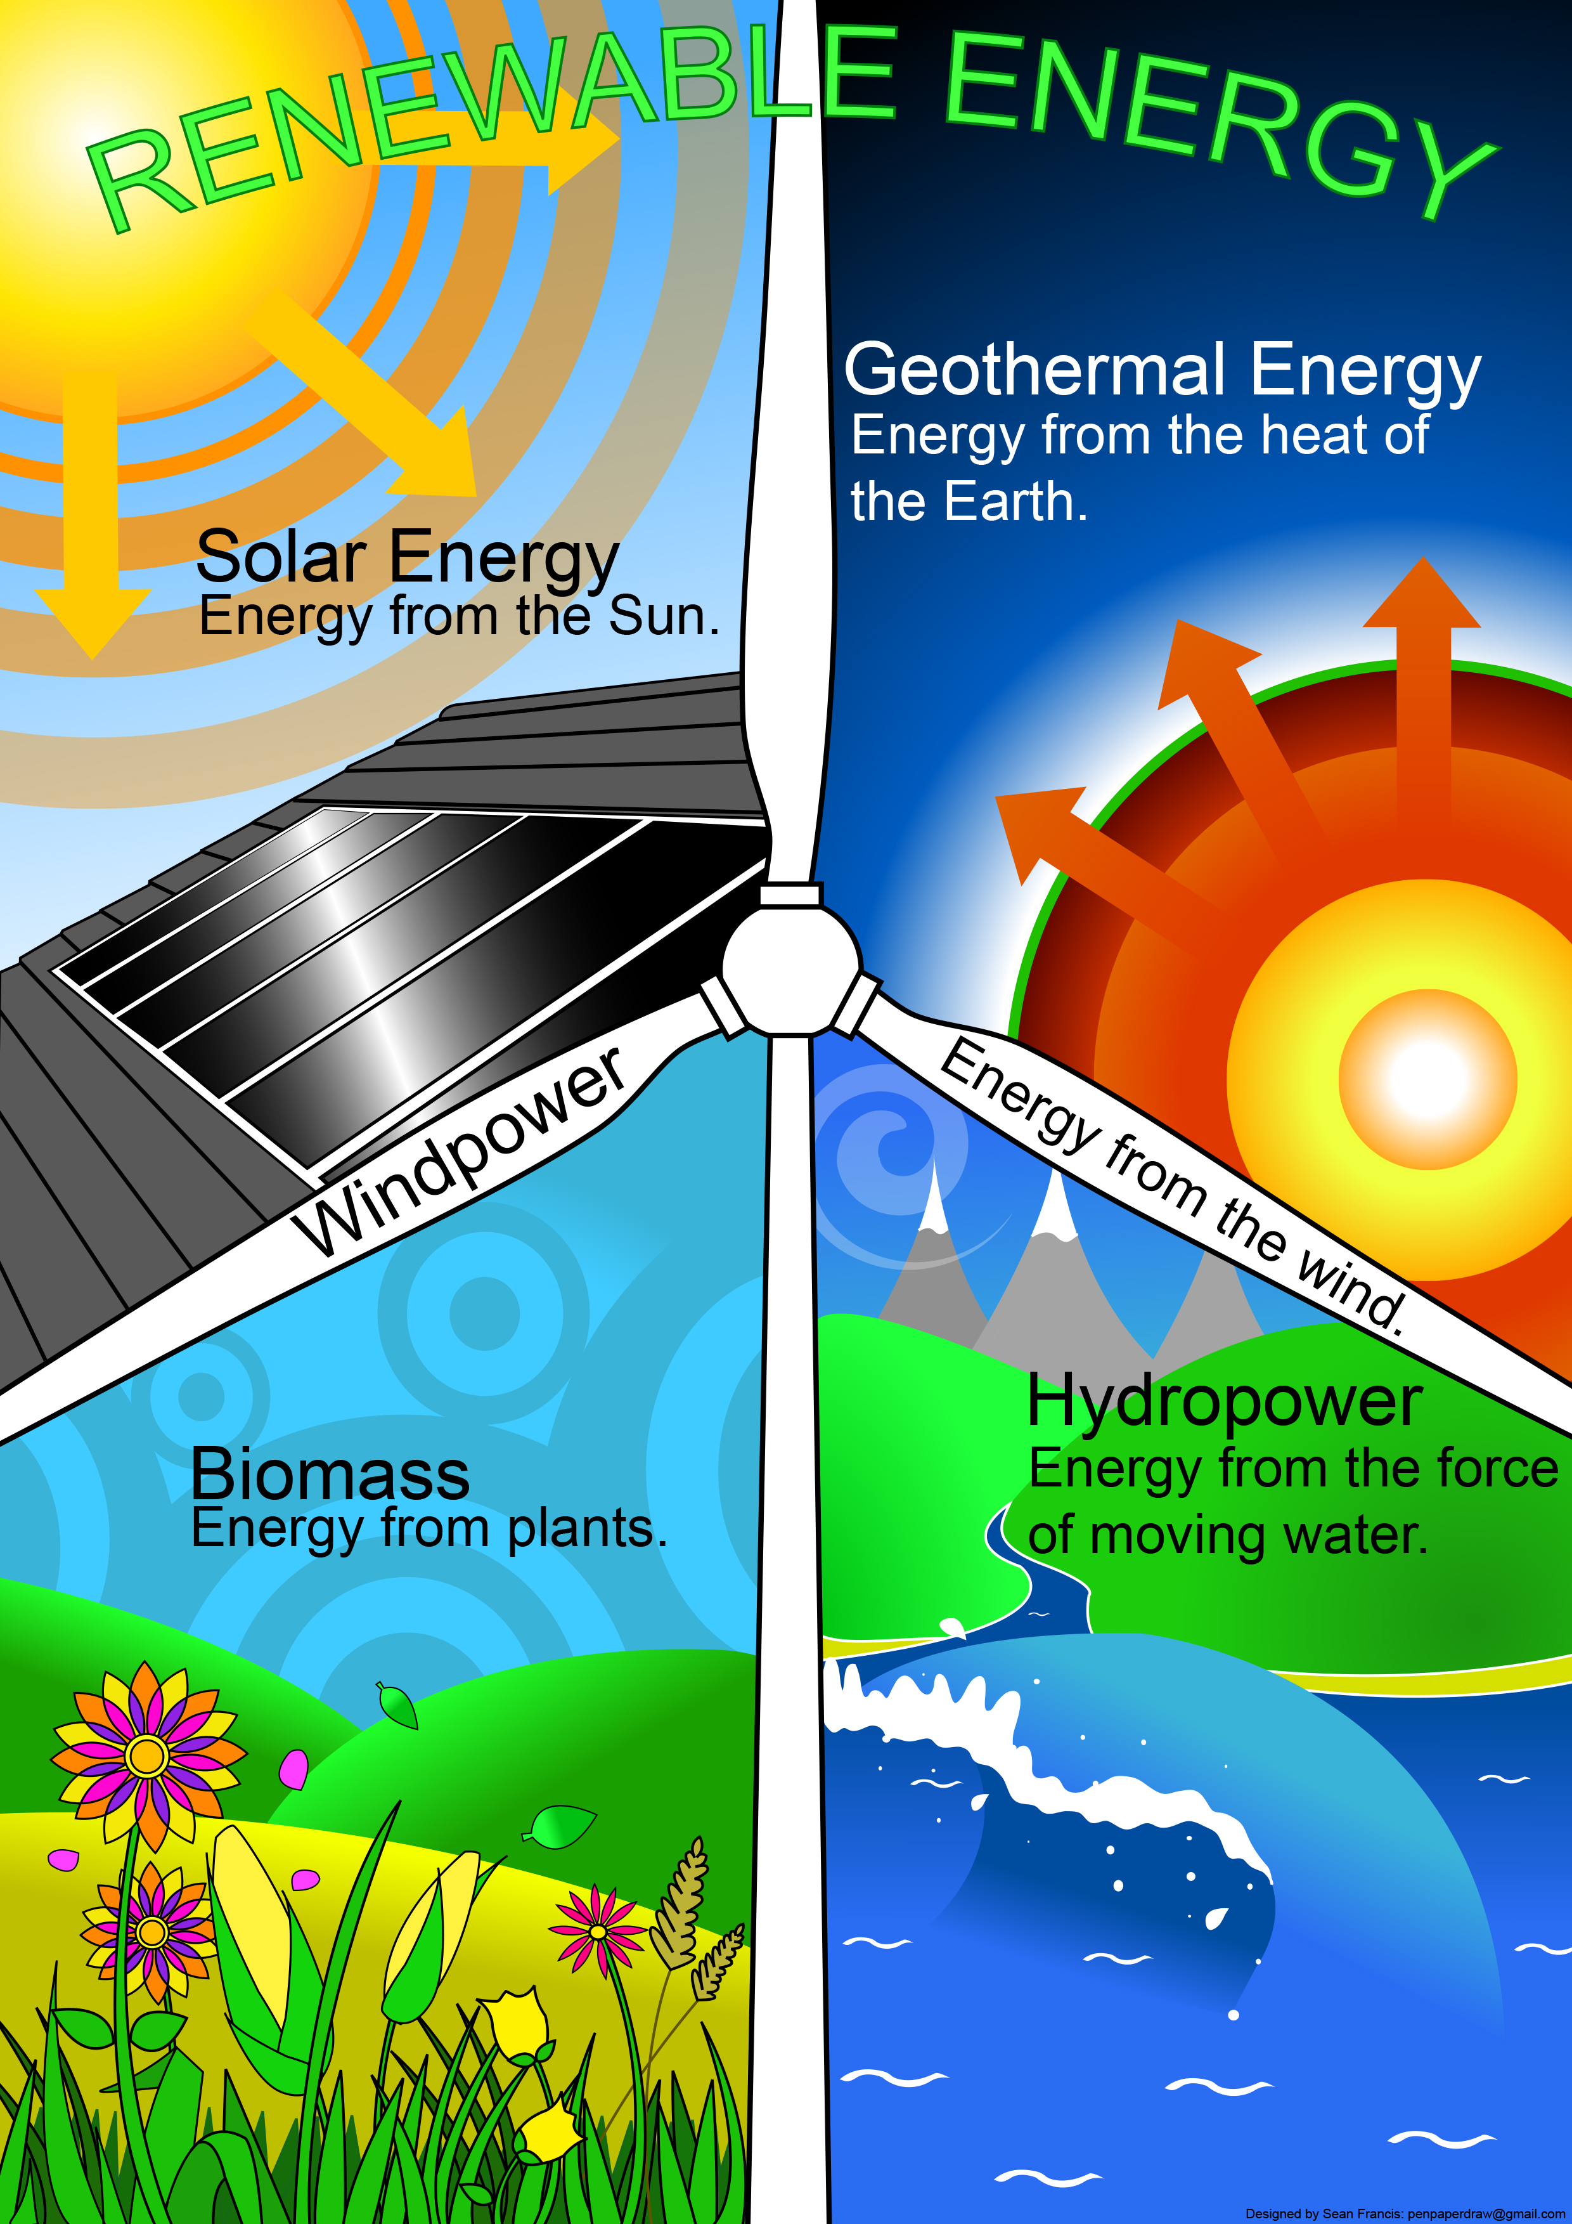
INFORMATIVE Posters
Their purpose, language features, structure and stages

Slide 2
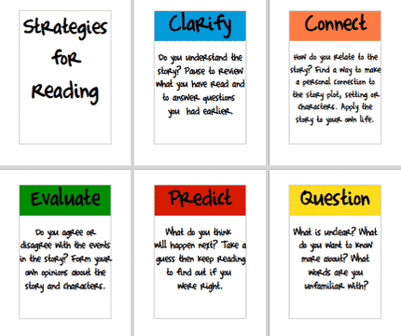
INFORMATIVE PostersI
Stage 2:Use headings. Organise your information under the headings.
Purpose: To give information on a topic.
Stage 3: Use other ways to share the information – diagram, photos, text box, etc.
Stage 1:Choose the information: What is it you want to share?
Find examples of informative posters in the classroom.
Overall Structure: Large enough to be clearly seen and read. Choose a graphic organizer that works best with the information. Plan your layout.

Slide 3
INFORMATIVE PostersI
Informative: Facts and evidence
LANGUAGE FEATURES
Sequenced under headings, in topic paragraphs
Similar to the language features of any information text
Find examples of informative posters in the school.
Use words strategically. Give enough information but not too much.
There may be subject specific words and phrases.
Headings, sub-headings Captions, labelled diagrams may be used.

Slide 4
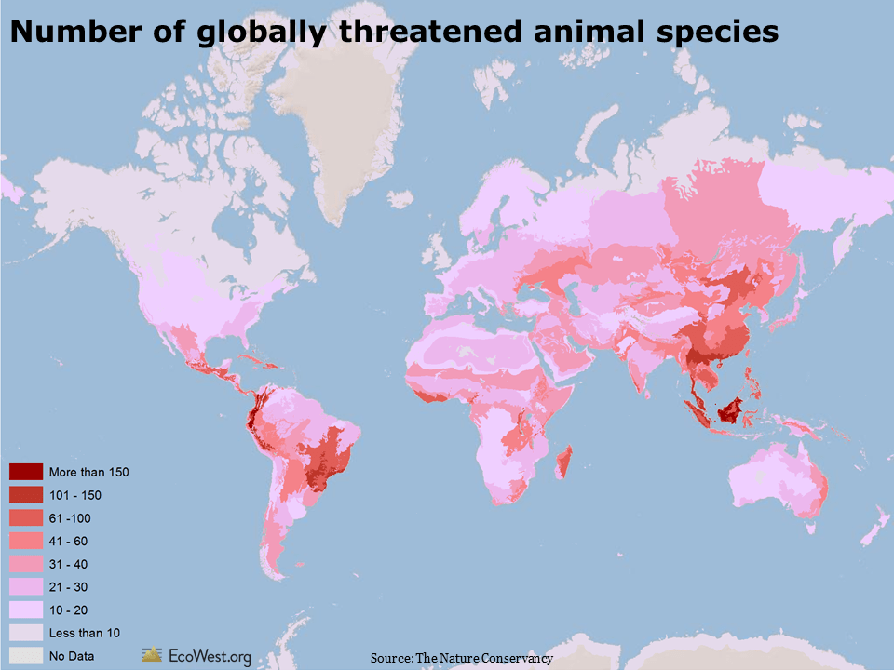
Examples of Informative Posters
Headings, diagrams, tables,
Purpose: To give information on a topic.
How you decide to organise and set out your information is important. Plan your structure carefully.
Use of map and colour key to organise information

