Slide 1
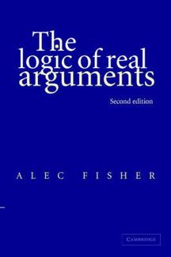
Argument

Slide 2
An argument is a written or spoken piece of communication. Its purpose is to logically and with evidence prove a particular point of view.
Structure
Paragraphs, with 1 idea for each paragraph
Dot points within a paragraph
The language features of an argument include : factual statements, informative language such as “the facts prove ...” , mostly impersonal and unemotional.
Stages
Introduction
Body
Conclusion based on evidence

Slide 3
Stage – Body Structure – paragraphs, with statements and evidence
1. Should Physical Education be mandatory in Primary Schools? Given the great body of evidence in favour of Phys Ed in schools, the answer must always be YES!
Introduce yourself as speaker or writer (sometimes).
Introduce the topic, which is the purpose of the argument.
2. I am a teacher in a Primary school, and I write to support the statement that Physical Education should indeed be mandatory in all Primary schools.

Slide 4
Stage – Body Structure – paragraphs, with statements and evidence
Firstly, Physical Education helps children to stay active and healthy. According to medical institutions and organisations, children should get at least 60 minutes of physical activity each day.
Physical education also teaches important life skills – teamwork, leadership, problem solving, building friendships. These are proven valuable skills for school, socially and into the future.

Slide 5
Stage – Body Structure – paragraphs, with statements and evidence (Cont.)
Physical education is a fun way to learn. Many children enjoy involvement in sporting activities and physical education allows opportunities for learning new skills, discovering new interests and exploring new activities. A survey conducted by the National association for Sport and Educations found that 70% of children stated that they enjoy physical Education at school.
The Physical Education subject in Australian primary schools also covers healthy eating and other health related topics. These are valuable and vital areas of children’s education which must be offered in all schools.

Slide 6
Stage – Conclusion Structure – Paragraph. Repeat the purpose and concluding statements
Is it now clear that Physical Education should be a subject in Primary Australian schools? Not only does it promote good health and healthy habits, skills are developed and new skills are learned, and it provides a variety of enjoyable experiences as children learn and grow.

Slide 7
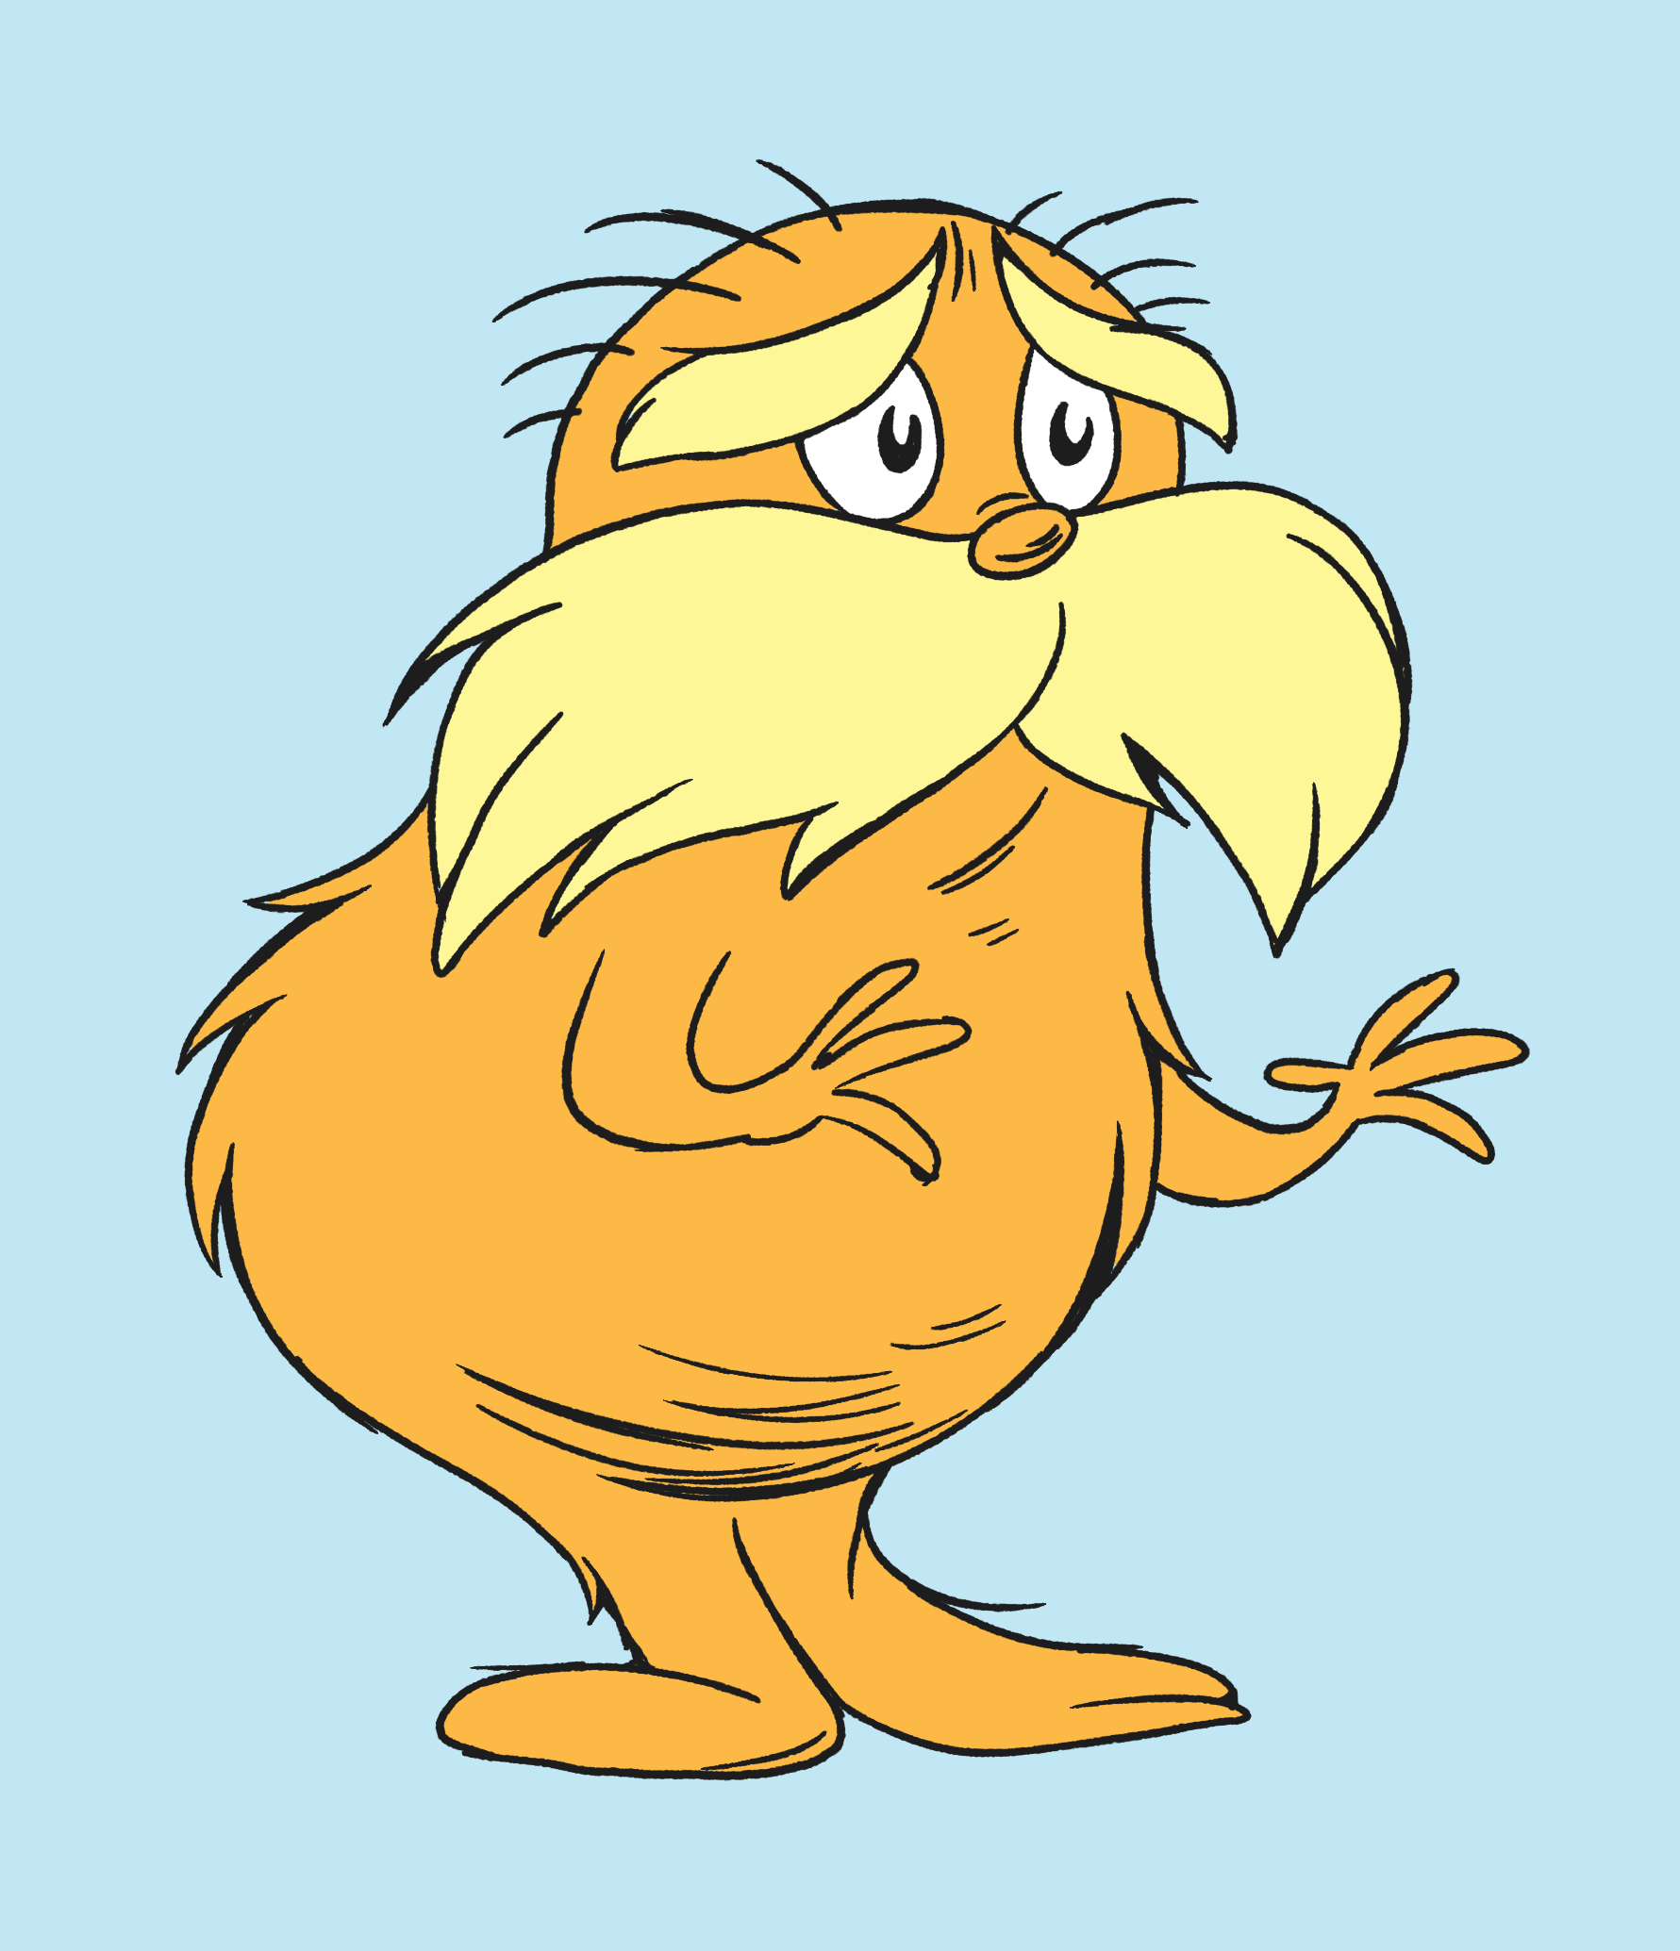
Stage - Introduction Structure - Statement
Introduction of speaker or writer.
“I am the Lorax.”
Introduction of the topic
“I speak for the trees. I speak for the trees for the trees have no tongues.”

Slide 8
Stage – Body Structure – Paragraph with fact and evidence
Facts
“Once-ler! You are making such smogulous smoke!
My poor Swomee Swans ... Why they can’t sing a note!
No one can sing who has smog in his throat.
Evidence

Slide 9
Stage – Body Structure – Paragraph with fact and evidence
Facts
“Your glumping the pond where the Humming – Fish hummed.
No more can they hum, for their gills are all gummed.
Evidence

Slide 10
Stage – Conclusion
Structure – Paragraph, final statement
Unless someone like you cares a whole awful lot, nothing is going to get better.
It’s not.

Slide 11
THINK AND SHARE
The author has a point of view. What is it?
Why did the author choose to write his argument as a children’s picture book?
Did the Lorax win or lose the argument? Discuss
Did the author convince you? Why or why not? Discuss.

