Slide 1
Brochures and Information Reports
Purpose, Structure and Stages
Yr 4

Slide 2
Structure: Folded, with information and/or images on all faces of the page.
BROCHURE
Language Features:
Persuasive, descriptive, interesting, words and information that capture your mind and heart.
The hotel has a swimming pool (boring) ....... Soak up the sunshine as you laze beside the sparkling water of the hotel’s beautiful pool!
PURPOSE: To advertise, market, promote a person, place or thing.
Notes:
Companies often use brochures to promote their products or services. A brochure is a promotional document primarily used to introduce a company, organization, products, or services and inform prospective customers or members of the public of the benefits For a brochure to be effective, it needs the following three key elements:
A compelling copy.
An easy-to-read layout.
A simple yet eye-catching graphic design.
Each brochure should contain the following elements: a headline, brand elements, contact information, a call to action, text, and visuals.19 May 2022 They introduce. Chances are your reader has never heard of you, or your company, or your products or services, or how any of this stands out from your competitors. ...
They inform. ...
They persuade. ...
They are complete. ...
They are consistent.
Keep it easy for your customers to read by offering small amounts of information on the front cover and small inside panel. Use the inside three panels for your product descriptions and services. Avoid placing important information on the far right inside panel.

Slide 3
BROCHURE
The cover (first) page is designed to catch the reader's attention It should have an eye-catching design and clearly state the purpose of the brochure.
Structure
Brochures usually look different to other texts because they are often folded and both sides of the paper are used.
This makes them easy to be carried. They can also be folded out and displayed as a poster.
Contact information such as a phone number, email address, and website is usually on the back.
This provides the reader with the necessary information to get in touch with the company,
Main Body: The text is written under headings or in a way that can be easily followed by the reader.
Materials such as graphs, charts, images, which support the information is also presented in the main body.

Slide 4
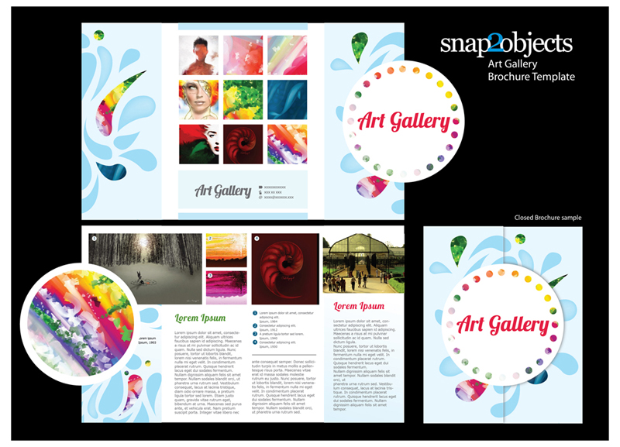
Planning Stages of the Brochure
Stage 1
Plan
Purpose
Main Idea
Audience?
Logo or Brand
Images and Text
Stage 2
Design
Font and size Bright colours
Not cluttered
What images?
Text under headings or in paragraphs?
Stage 3
Layout
Where to place images and text
Easy to Read
Attractive,
Eye-catching.
Contact Information on the back.

Slide 5
Structure: Usually presented in an organized way with headings and sub headings to break up the text and make the information easier to read and understand.
Language Features:
Language is neutral, factual and objective..
Soak up the sunshine as you laze beside the sparkling water of the hotel’s beautiful pool! (personal, persuasive)
The hotel has a swimming pool (fact, neutral, no personal opinion) .......
INFORMATION REPORT
PURPOSE: to inform, present facts about an object, living thing, place or event in a clear and logical way.
Notes:
The purpose of an information report is to provide a clear and concise overview of a particular subject or topic. It is used to inform the reader about a particular issue, concept, event, or process. The information in an information report is usually presented in a structured and organized manner, with headings and subheadings used to break up the text and make it easier to understand.
The main objective of an information report is to present information in a neutral and objective manner, without any personal opinions or biases. The goal is to educate the reader and provide them with accurate and relevant information that they can use to make informed decisions or understand a particular subject better.
Information reports can be used in a variety of settings, including education, business, government, and media. They can take the form of written reports, oral presentations, or multimedia presentations. Regardless of the format, the purpose of an information report is to communicate information clearly and effectively to its intended audience.

Slide 6
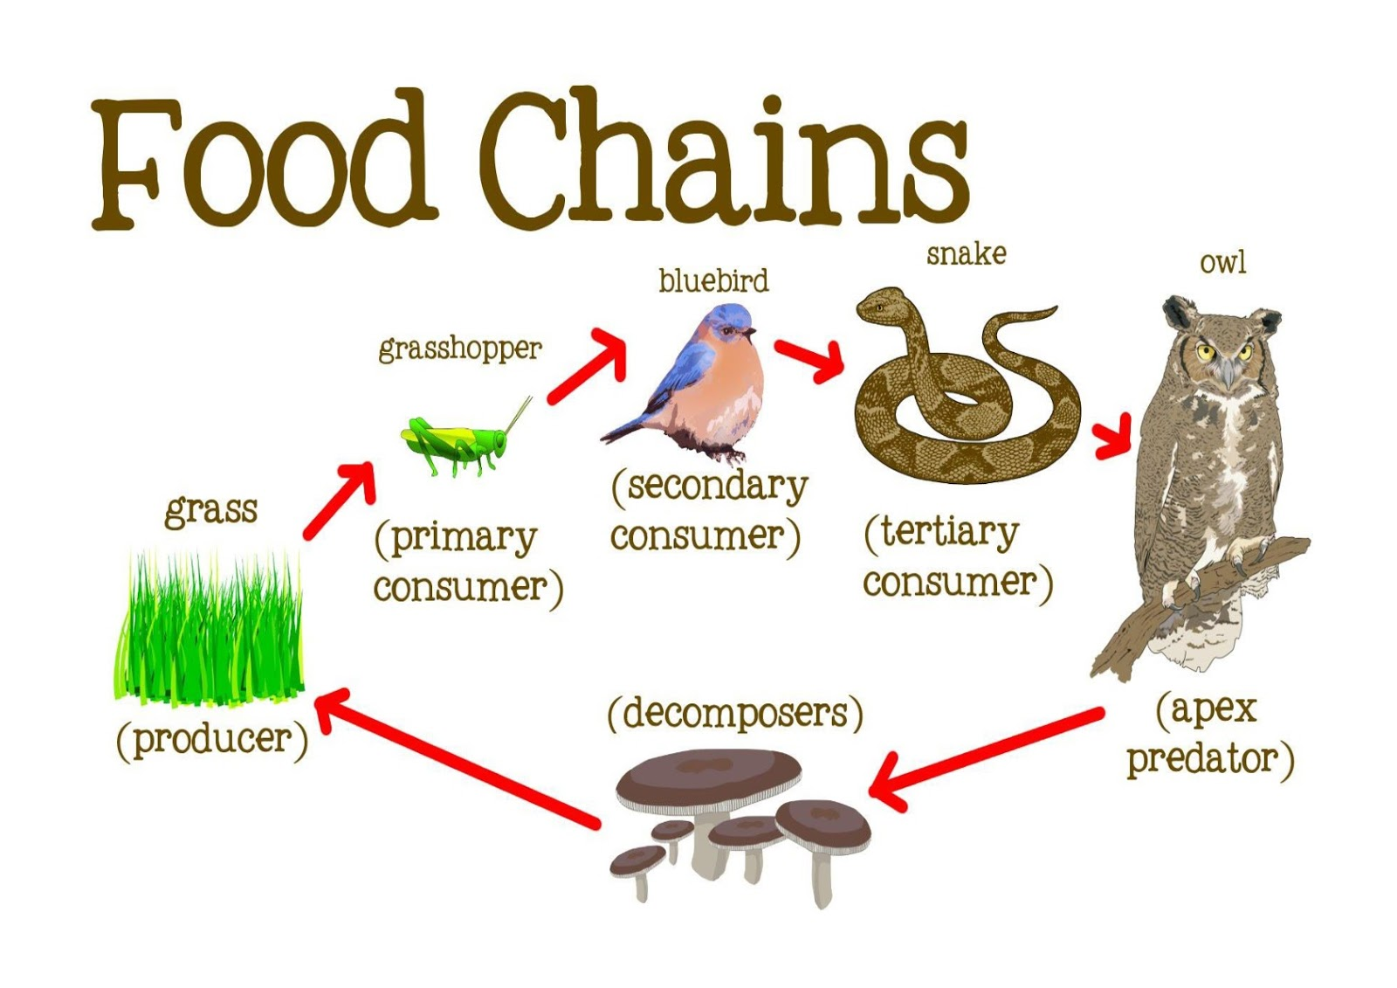
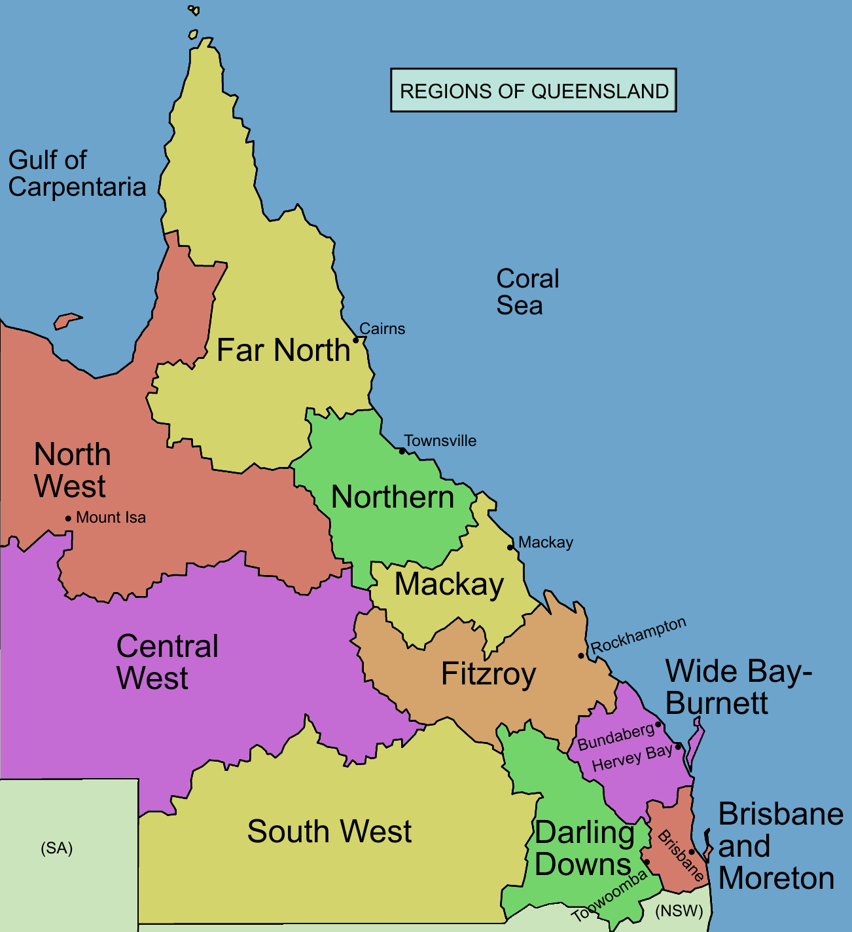
INFORMATION REPORT
Structure
Information reports are structured so that the information can be clearly organised. Most information reports use headings and sub-headings to do this.
The first sentence of an information report is usually a main or overall statement about the topic. For example, “Tigers are members of the cat family,” or “France is a country in Europe.”
The information report may also contain pictures, labelled diagrams, maps, tables, graphs, etc to help further explain and add to the information.

Slide 7
Stages of the Information report
Stage 4
Edit
Check for spelling and punctuation or have someone check for you.
More research if necessary.
Re-write unclear sentences.
Stage 1
Plan
Purpose
Main Idea
Audience?
Find resources
Gather information, pictures, etc
Note taking
Stage 2
Layout
Hand written or digital format?
Choose and arrange headings that best suit the information.
Discuss choices with a student or the teacher.
Stage 3
Draft
Organise notes under the correct headings.
Write a draft report : notes in sentences, use headings etc.
Stage 5 Final: Write the good copy of the report
Notes:
The stages can vary depending on context. Particularly in a classroom setting, for example, students may be given a template of stages which may include headings, to work with.

