Slide 1
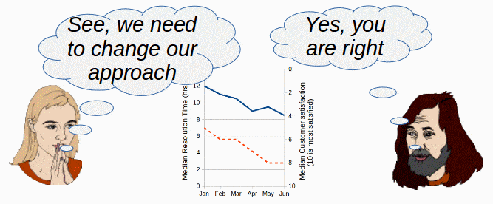
Persuasive Text: Letter to the community

Slide 2
A persuasive text is a written piece of communication. Its purpose is to persuade or convince the reader to take a particular action or to adopt a particular point of view. The language features of a persuasive text include:

Slide 3
Language Features of Persuasive Text
personal,
Strong and emotional words
sense of urgency
empowering,
Inspiring and motivating
Repetition
Confident tone
call to action
Notes:
Find these language features in the next few slides

Slide 4
STAGE 1: INTRODUCTION
Dear Community Members,
I am writing to you today to bring your attention to an important
issue that affects us all: habitat preservation. As we continue to
develop our communities and expand our infrastructure, we are
encroaching on the natural habitats of many species of plants
and animals. This has resulted in a significant loss of
biodiversity and disruption of the delicate balance of our
ecosystems.
Personal
Confident tone
Our actions
Negative Consequences
IS IT A FACT?

Slide 5
STAGE 2: BODY
It is important that we act now to preserve our habitats
and protect the plants and animals that call them home.
There are several steps that we can take to help
preserve our habitats, including:
Educating ourselves and our community about the
importance of habitat preservation and the impacts of
human activity on the environment.
A sense of urgency; a call to action!
Empower the people. Make it personal.
Repetition of the purpose

Slide 6
STAGE 2: (Cont.)
Encouraging sustainable land use practices, such as
minimising the impact of developement on natural
habitats.
Promoting the use of environmentally friendly
technologies and practices in our daily lives, such as
recycling and reducing energy consumption.
Advocating for policies and regulations that protect
natural habitats and promote sustainable development.
Empower the people. Make it personal.
Repetition of the purpose

Slide 7
STAGE 3: CONCLUSION
An emotional appeal with strong, emotional words. Inspiring and motivating.
Recaps the Purpose
Together we can make a difference in preserving
our habitats and protecting the biodiversity of our communities.
Let us come together and take action to ensure a healthy and vibrant future for all.
Sincerely
(Your name)
Positive consequences
A call to action

Slide 8
What text is this?
persuasive
Personal, emotional, sense of urgency, empowering, inspiring, motivating, call to action.
What language features of persuasive text did we find?
Facts, examples information
What would have made this text even stronger?

Slide 9
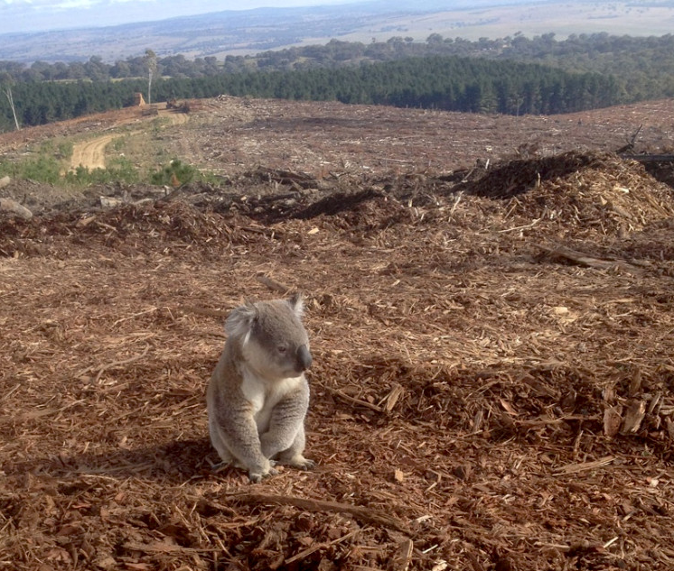
Stages and Phases of Persuasive Text
A PERSUASIVE TEXT CAN TAKE THE FORM OF A LETTER, SPEECH, BROCHURE, ADVERTISEMENT, POSTER ... AND MORE

Slide 10
Stage 1: Introduction - Engage the Reader
Phase
Background Information
We are encroaching on the natural habitats of many species of plants and animals.
This has resulted in a significant loss of biodiversity and disruption of the delicate balance of our ecosystems.
Phase
Present the argument and Introduce the purpose.
I am writing to you today to bring your attention to an important issue that affects us all: habitat preservation.
Grab the Reader’s attention!
Clearly state your purpose
Phase
Clear Statement of purpose .....
Habitat Preservation
Write with knowledge and confidence

Slide 11
Stage 2: Body- Present a Strong Argument Phases can vary ...
Phase
Supporting evidence:
The writer presents evidence to support their argument. This can include facts, statistics, examples, and expert opinions.
This has resulted in a significant loss of
biodiversity and disruption of the delicate balance of our
ecosystems.
Phase Solutions
There are several steps that we can take to help preserve our habitats...
Will the argument convince the reader?
Phase Refutation: The writer provides evidence to disprove the opposing viewpoints. This demonstrates the weaknesses in the opposing arguments and strengthens the writer's own argument.
Phase Counterarguments: The writer acknowledges and addresses opposing viewpoints.

Slide 12
Stage 3: Conclusion Take Action!
Emotional and personal
Inspire action!
Phase
Repeat the Purpose
Together we can make a difference in preserving
our habitats
Call to Action!
Let us come together and take action
Encourage and inspire the Reader to act!
Strong, positive and convincing

